Slide 1
Machine Learning Foundation Project
Alexa Reviews Analysis using Decision Tree and Random Forest Algorithm
By SURESH MANEM

Slide 2
Objective
The objective is to discover insights into consumer reviews and perform Sentiment Analysis on the data.
Dataset consists of 3000 Amazon customer reviews, star ratings, date of review, variant and feedback of various amazon Alexa products like Alexa Echo, Echo dots.
Dataset: www.kaggle.com/sid321axn/amazon-alexa-reviews

Slide 3
DataSet Information
Information in DataSet:
'rating', 'date', 'variation', 'verified_reviews', 'feedback‘
Total Feedback Count
Field Name | Count
Rating | 3150
Date | 3150
Variation | 3150
Verified_Reviews | 3150
Feedback | 3150

Slide 4
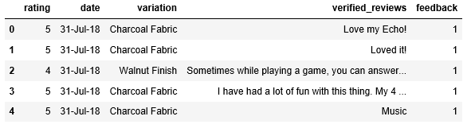
DataSet Information
Variations
The Alexa Products considered are: 'Charcoal Fabric ', 'Walnut Finish ', 'Heather Gray Fabric ', 'Sandstone Fabric ', 'Oak Finish ', 'Black', 'White', 'Black Spot', 'White Spot', 'Black Show', 'White Show', 'Black Plus', 'White Plus', 'Configuration: Fire TV Stick', 'Black Dot', 'White Dot‘
Sample Data

Slide 5
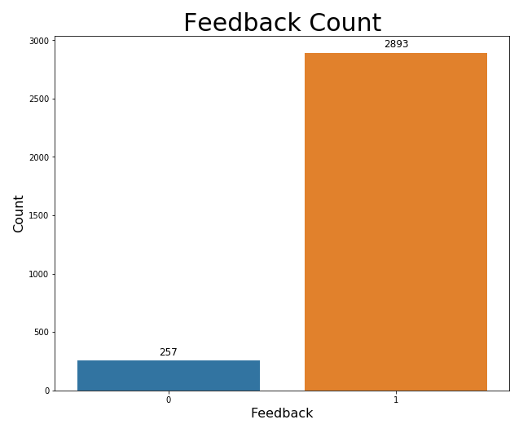
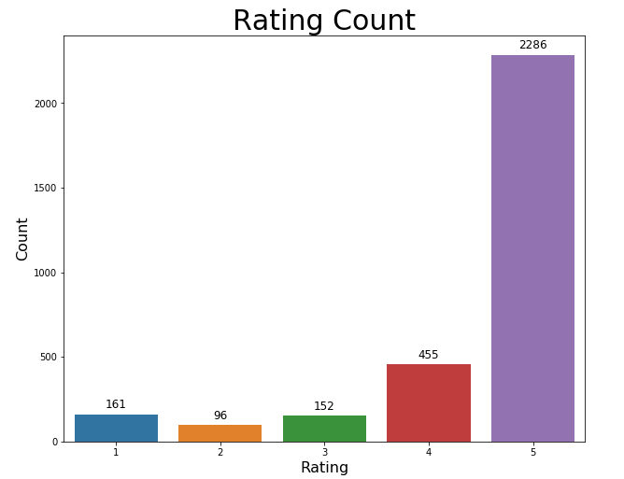
Count Plots

Slide 6
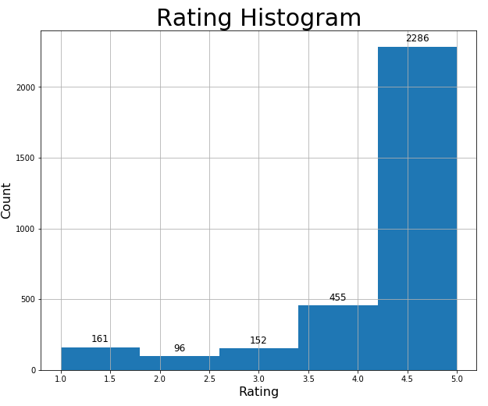
Rating Distributions

Slide 7
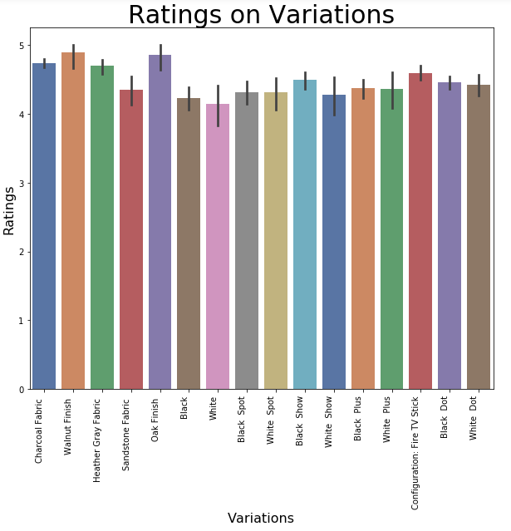
Rating Variations

Slide 8
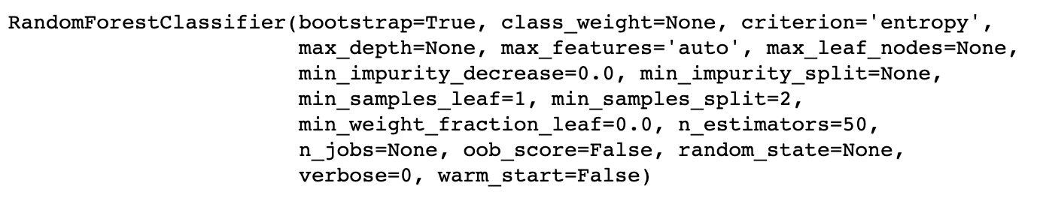
Training Model
Random Forest Classifier training the data for 50 estimators

Slide 9
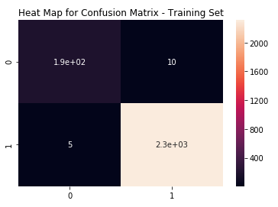
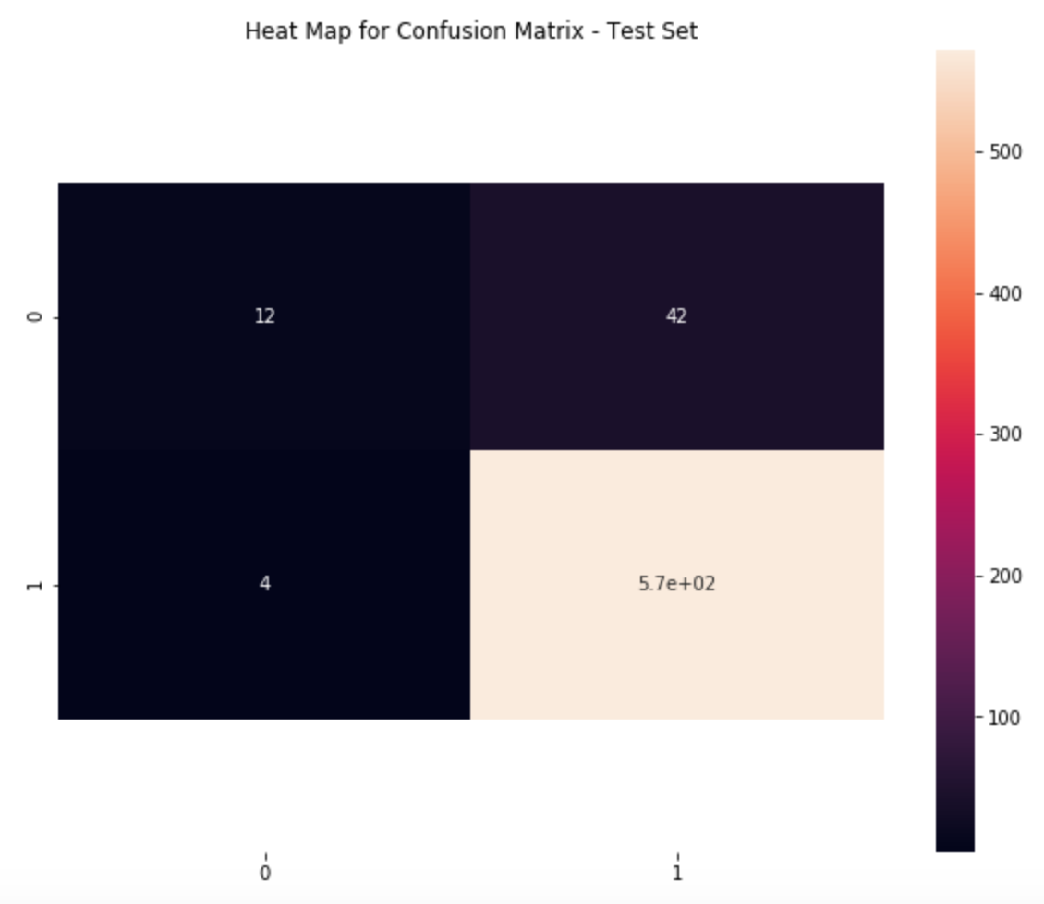
Evaluating Model
Data Set | True Positive | True Negative | False Positive | False Negative | Accuracy | Precision | Recall | F-Score
Training Set | 2315 | 190 | 13 | 2 | 99.4% | 99.4% | 99.9% | 99.6%
Test Set | 572 | 12 | 42 | 4 | 93.1% | 93.1% | 99.8% | 96.3%

Slide 10
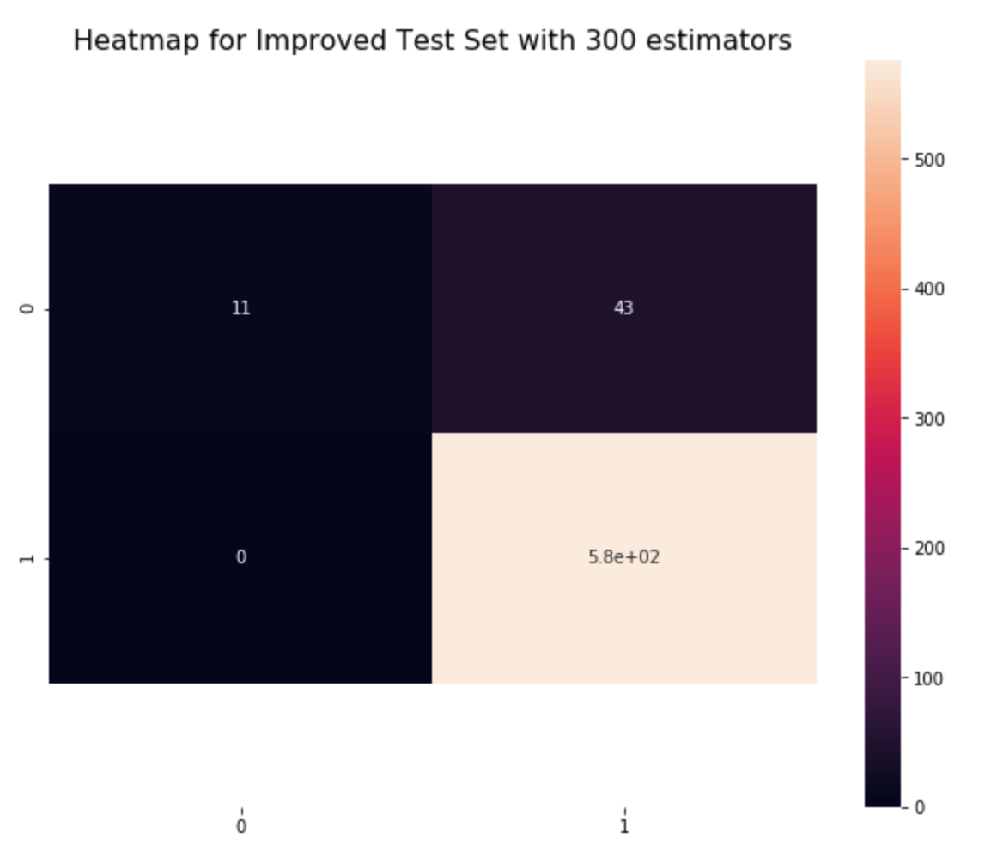
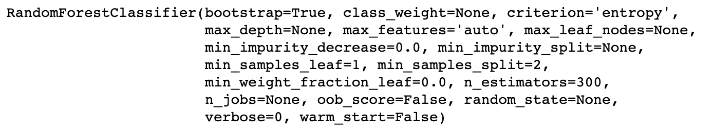
Improved Model
Data Set | True Positive | True Negative | False Positive | False Negative | Accuracy | Precision | Recall | F-Score
Test Set | 576 | 11 | 43 | 0 | 93.1% | 93.1% | 99.8% | 96.3%
Random Forest Classifier training the data for 300 estimators

Slide 11
Conclusion
Observed the improvement in the model in terms of Precision and Recall when compared with change in the estimators

Slide 12
aPPENDIX

Slide 13
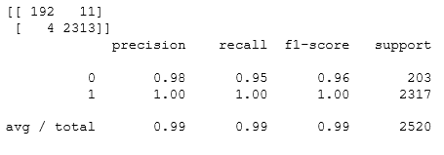
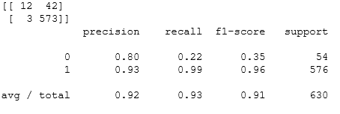
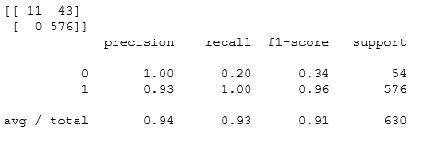
Sensitivity Analysis
Training Set
Test Set
Improved Model

Slide 14
DECISION TREES: INTUITION
Decision Trees are supervised Machine Learning technique where the data is split according to a certain condition/parameter.
Let’s assume we want to classify whether a customer could retire or not based on their savings and age.
Savings>$1M
AGE
Yes
No
45 years
Age > 45?
Class #0
Yes
No
Class #1
Class #0
$1 Million
SAVINGS

Slide 15
DECISION TREES: DEFINITIONS
The tree consists of decision nodes and leaves.
Leaves are the decisions or the final outcomes.
Decision nodes are where the data is split based on a certain attribute.
Objective is to minimize the entropy which provides the optimum split
DECISION NODES
Savings>$1M
Yes
No
Age > 45?
Class #0
Yes
No
LEAVES
Class #1
Class #0

Slide 16
DECISION TREES: CUSTOMER SEGMENTATION
Credit Score<750
CREDIT SCORE
Yes
No
Income<$200K
Income<$100K
750
Yes
No
Yes
No
650
Class #1
Credit Score<650
Class #0
Class #1
Yes
No
$100K
$200K
INCOME
Class #0
Class #1

Slide 17
RANDOM FOREST: INTUITION
Random Forest Classifier is a type of ensemble algorithm.
It creates a set of decision trees from randomly selected subset of training set.
It then combines votes from different decision trees to decide the final class of the test object.
TREE #1
TREE #2
TREE #N
Savings>$1M
Savings>$1M
Savings>$1M
Yes
No
Yes
No
Yes
No
Age > 45?
Class #0
Age > 45?
Class #0
Age > 45?
Class #0
Yes
No
Yes
No
Yes
No
Class #1
Class #0
Class #1
Class #0
Class #1
Class #0
OUT = CLASS #1
OUT = CLASS #1
OUT = CLASS #0
MAJORITY VOTE = CLASS #1

Slide 18
RANDOM FOREST: WHY AND HOW?
It overcomes the issues with single decision trees by reducing the effect of noise.
Overcomes overfitting problem by taking average of all the predictions, canceling out biases.
Suppose training set: [X1, X2, X3, X4] with labels: [L1, L2, L3, L4]
Random forest creates three decision trees taking inputs as follows:
[X1, X2, X3], [X1, X2, X4], [X2, X3, X4]
Example: Combining votes from a pool of experts, each will bring their own experience and background to solve the problem resulting in a better outcome.
Complete Training set
Training
set #1
Training
set #2
Training
set #3
Decision Tree #1
Decision Tree #2
Decision Tree #3
VOTING

